Slide 1
Project Logbook Plots
Tom Tyler
IIB Project
Open-source Data-driven Aerodynamic Turbine Design
(This logbook has a complimentary physical book)

Slide 2
Week 1

Slide 3
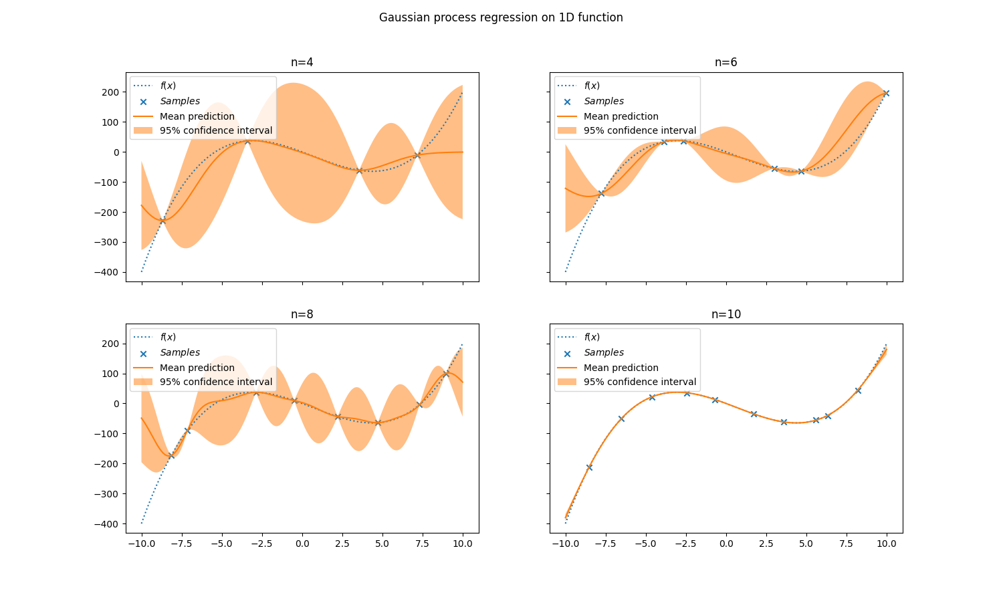
Fitting 1D Data - varying n

Slide 4
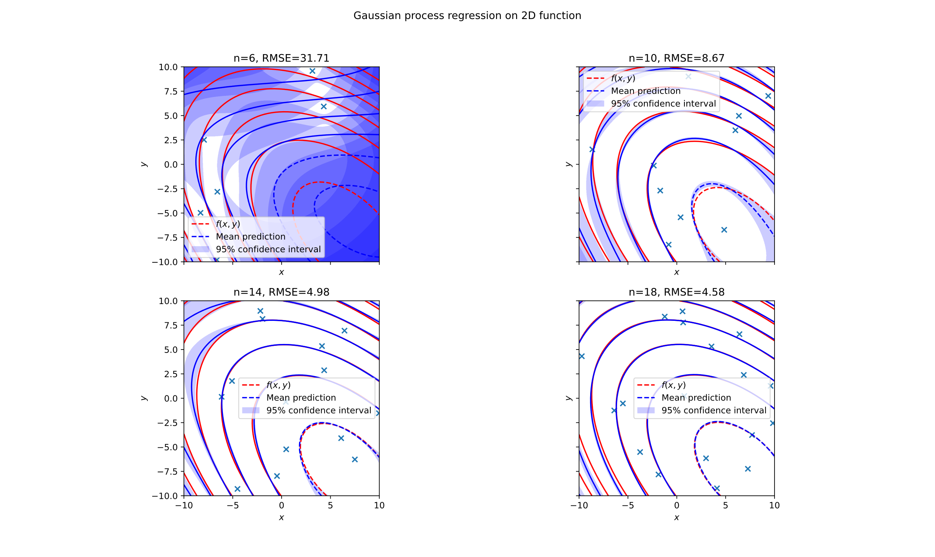
Fitting 2D Data - varying n

Slide 5
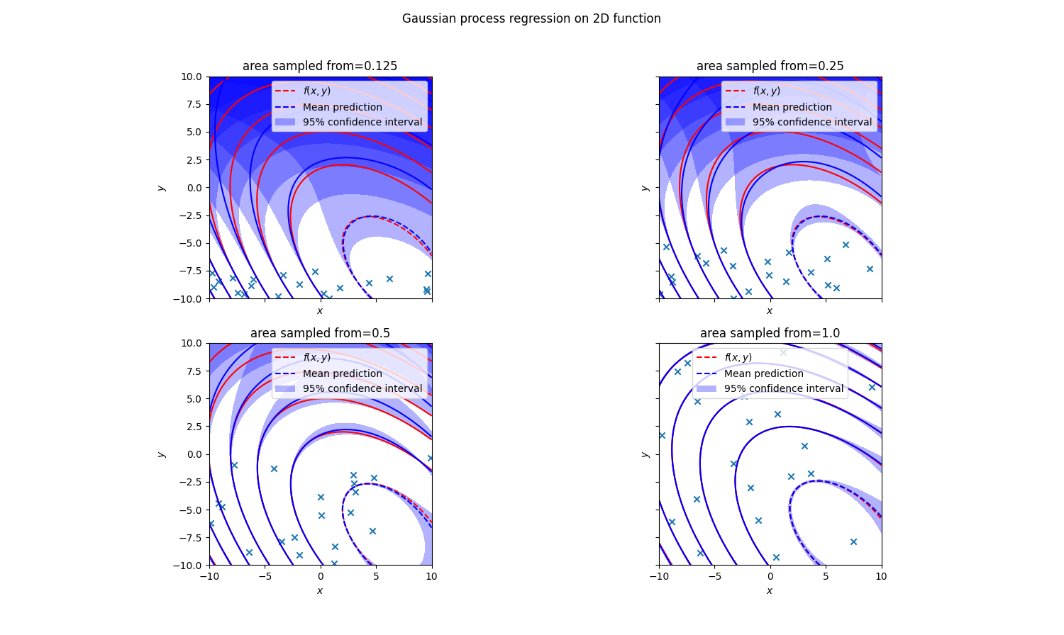
Fitting 2D data – vary space sampled from

Slide 6
Week 2

Slide 7
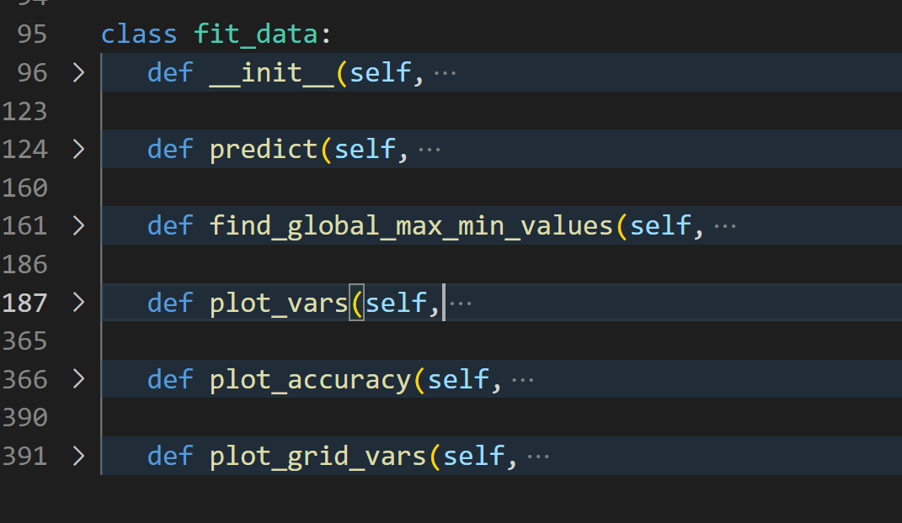
General code layout

Slide 8
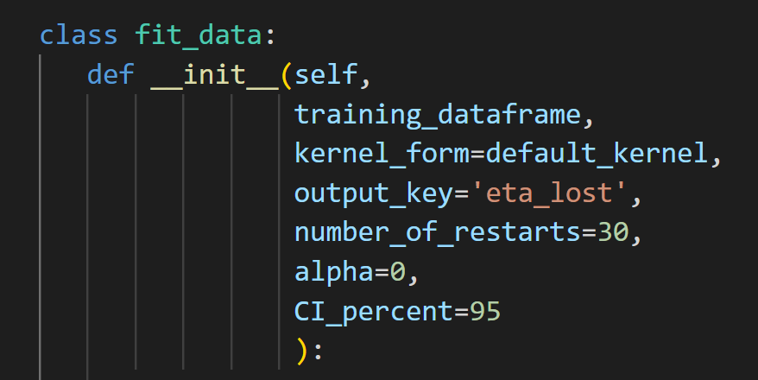
fit_data – create model

Slide 9
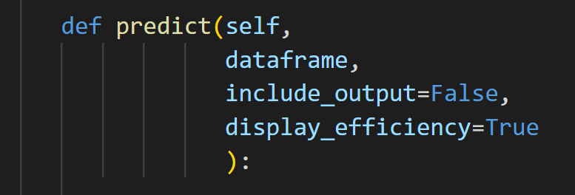
predict

Slide 10
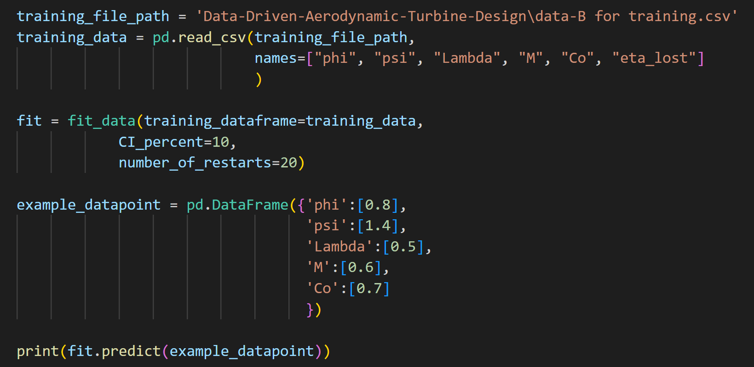
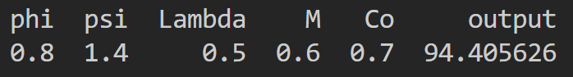
predict (example)

Slide 11
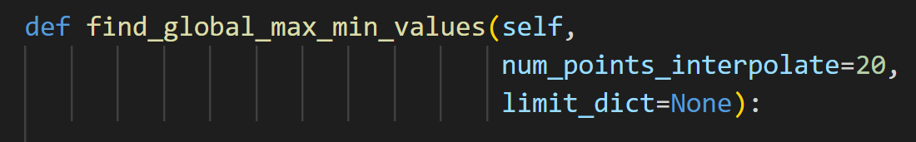
find_global_max_min_values
Number is small, as needs to find maximum value out of n⁵ data points. How can this be improved? Gradient descent? With 20, method takes 26 seconds (in debug mode)

Slide 12
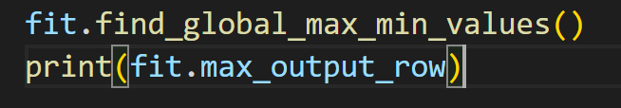
find_global_max_min_values (example)
Finds the maximum value without extrapolation

Slide 13
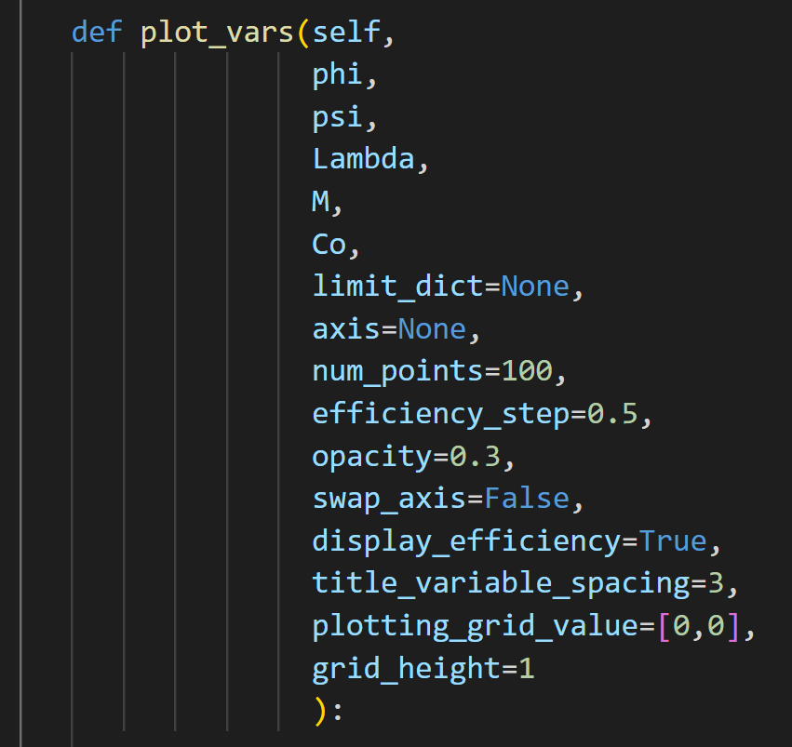
plot_vars

Slide 14
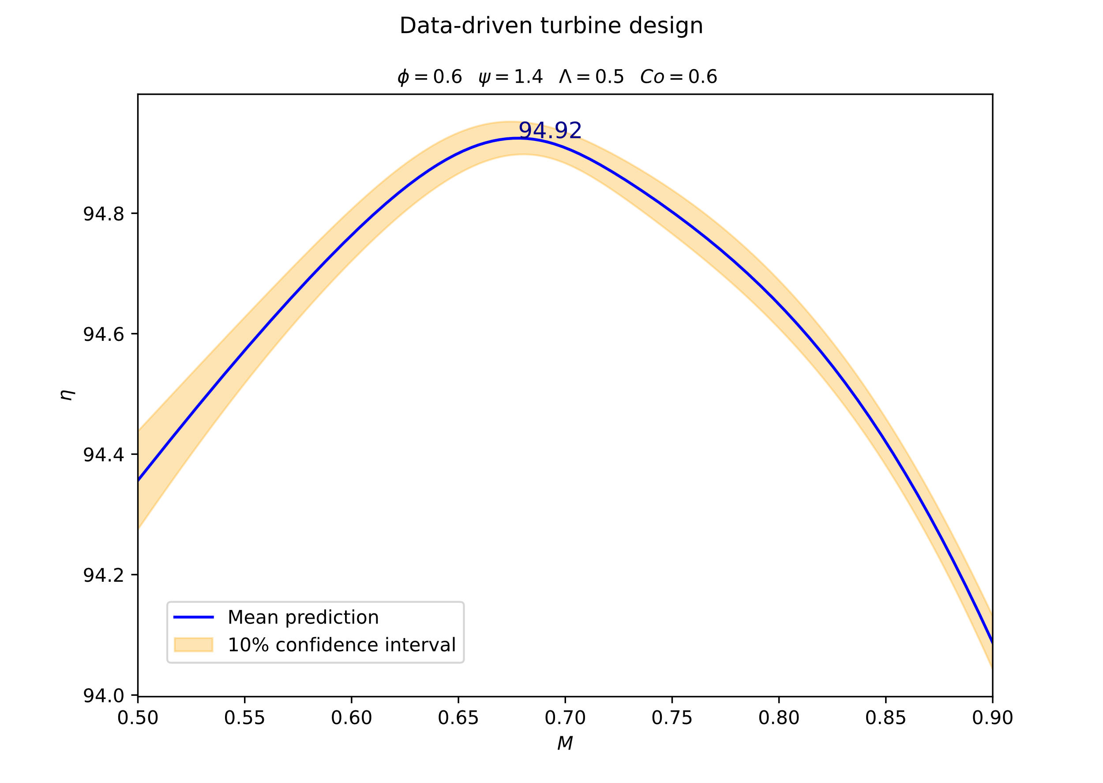
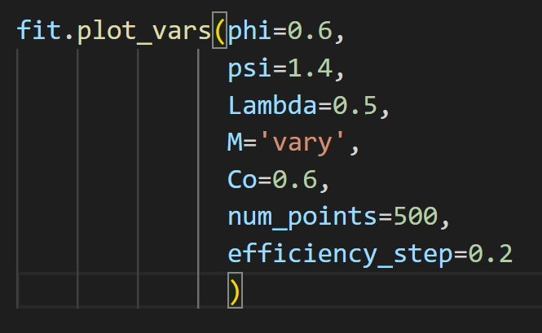
plot_vars (examples)

Slide 15
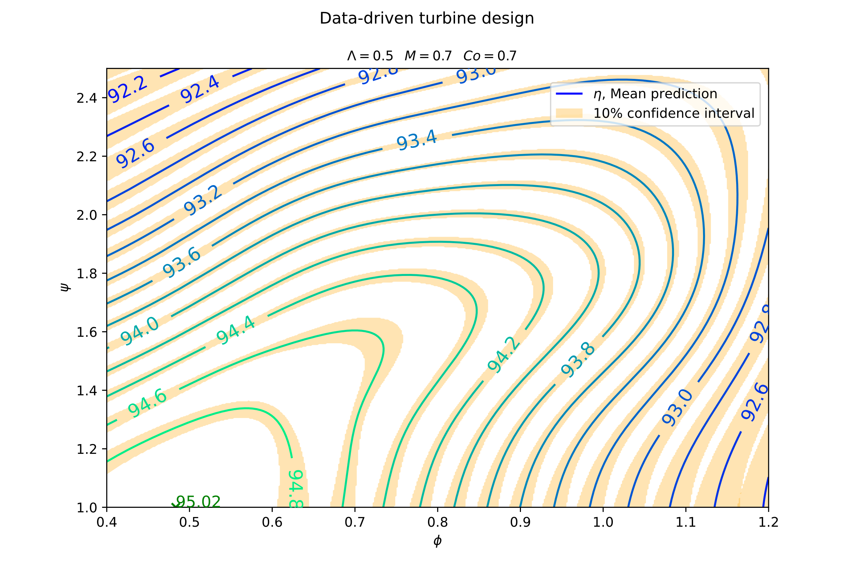
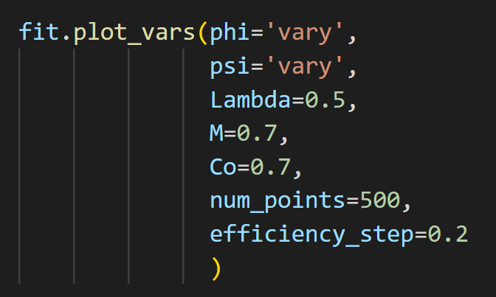
plot_vars (examples)

Slide 16
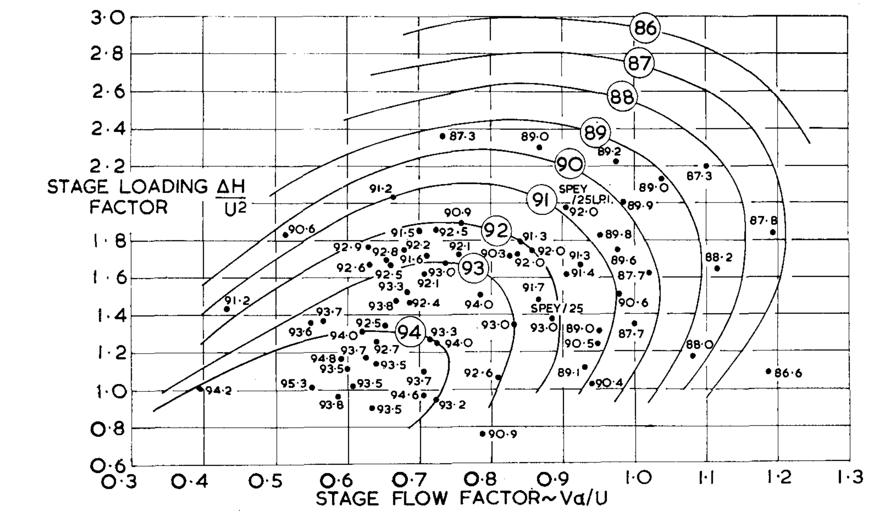
plot_vars (smith chart comparison)
Different axis
Do not know values of Co and M

Slide 17
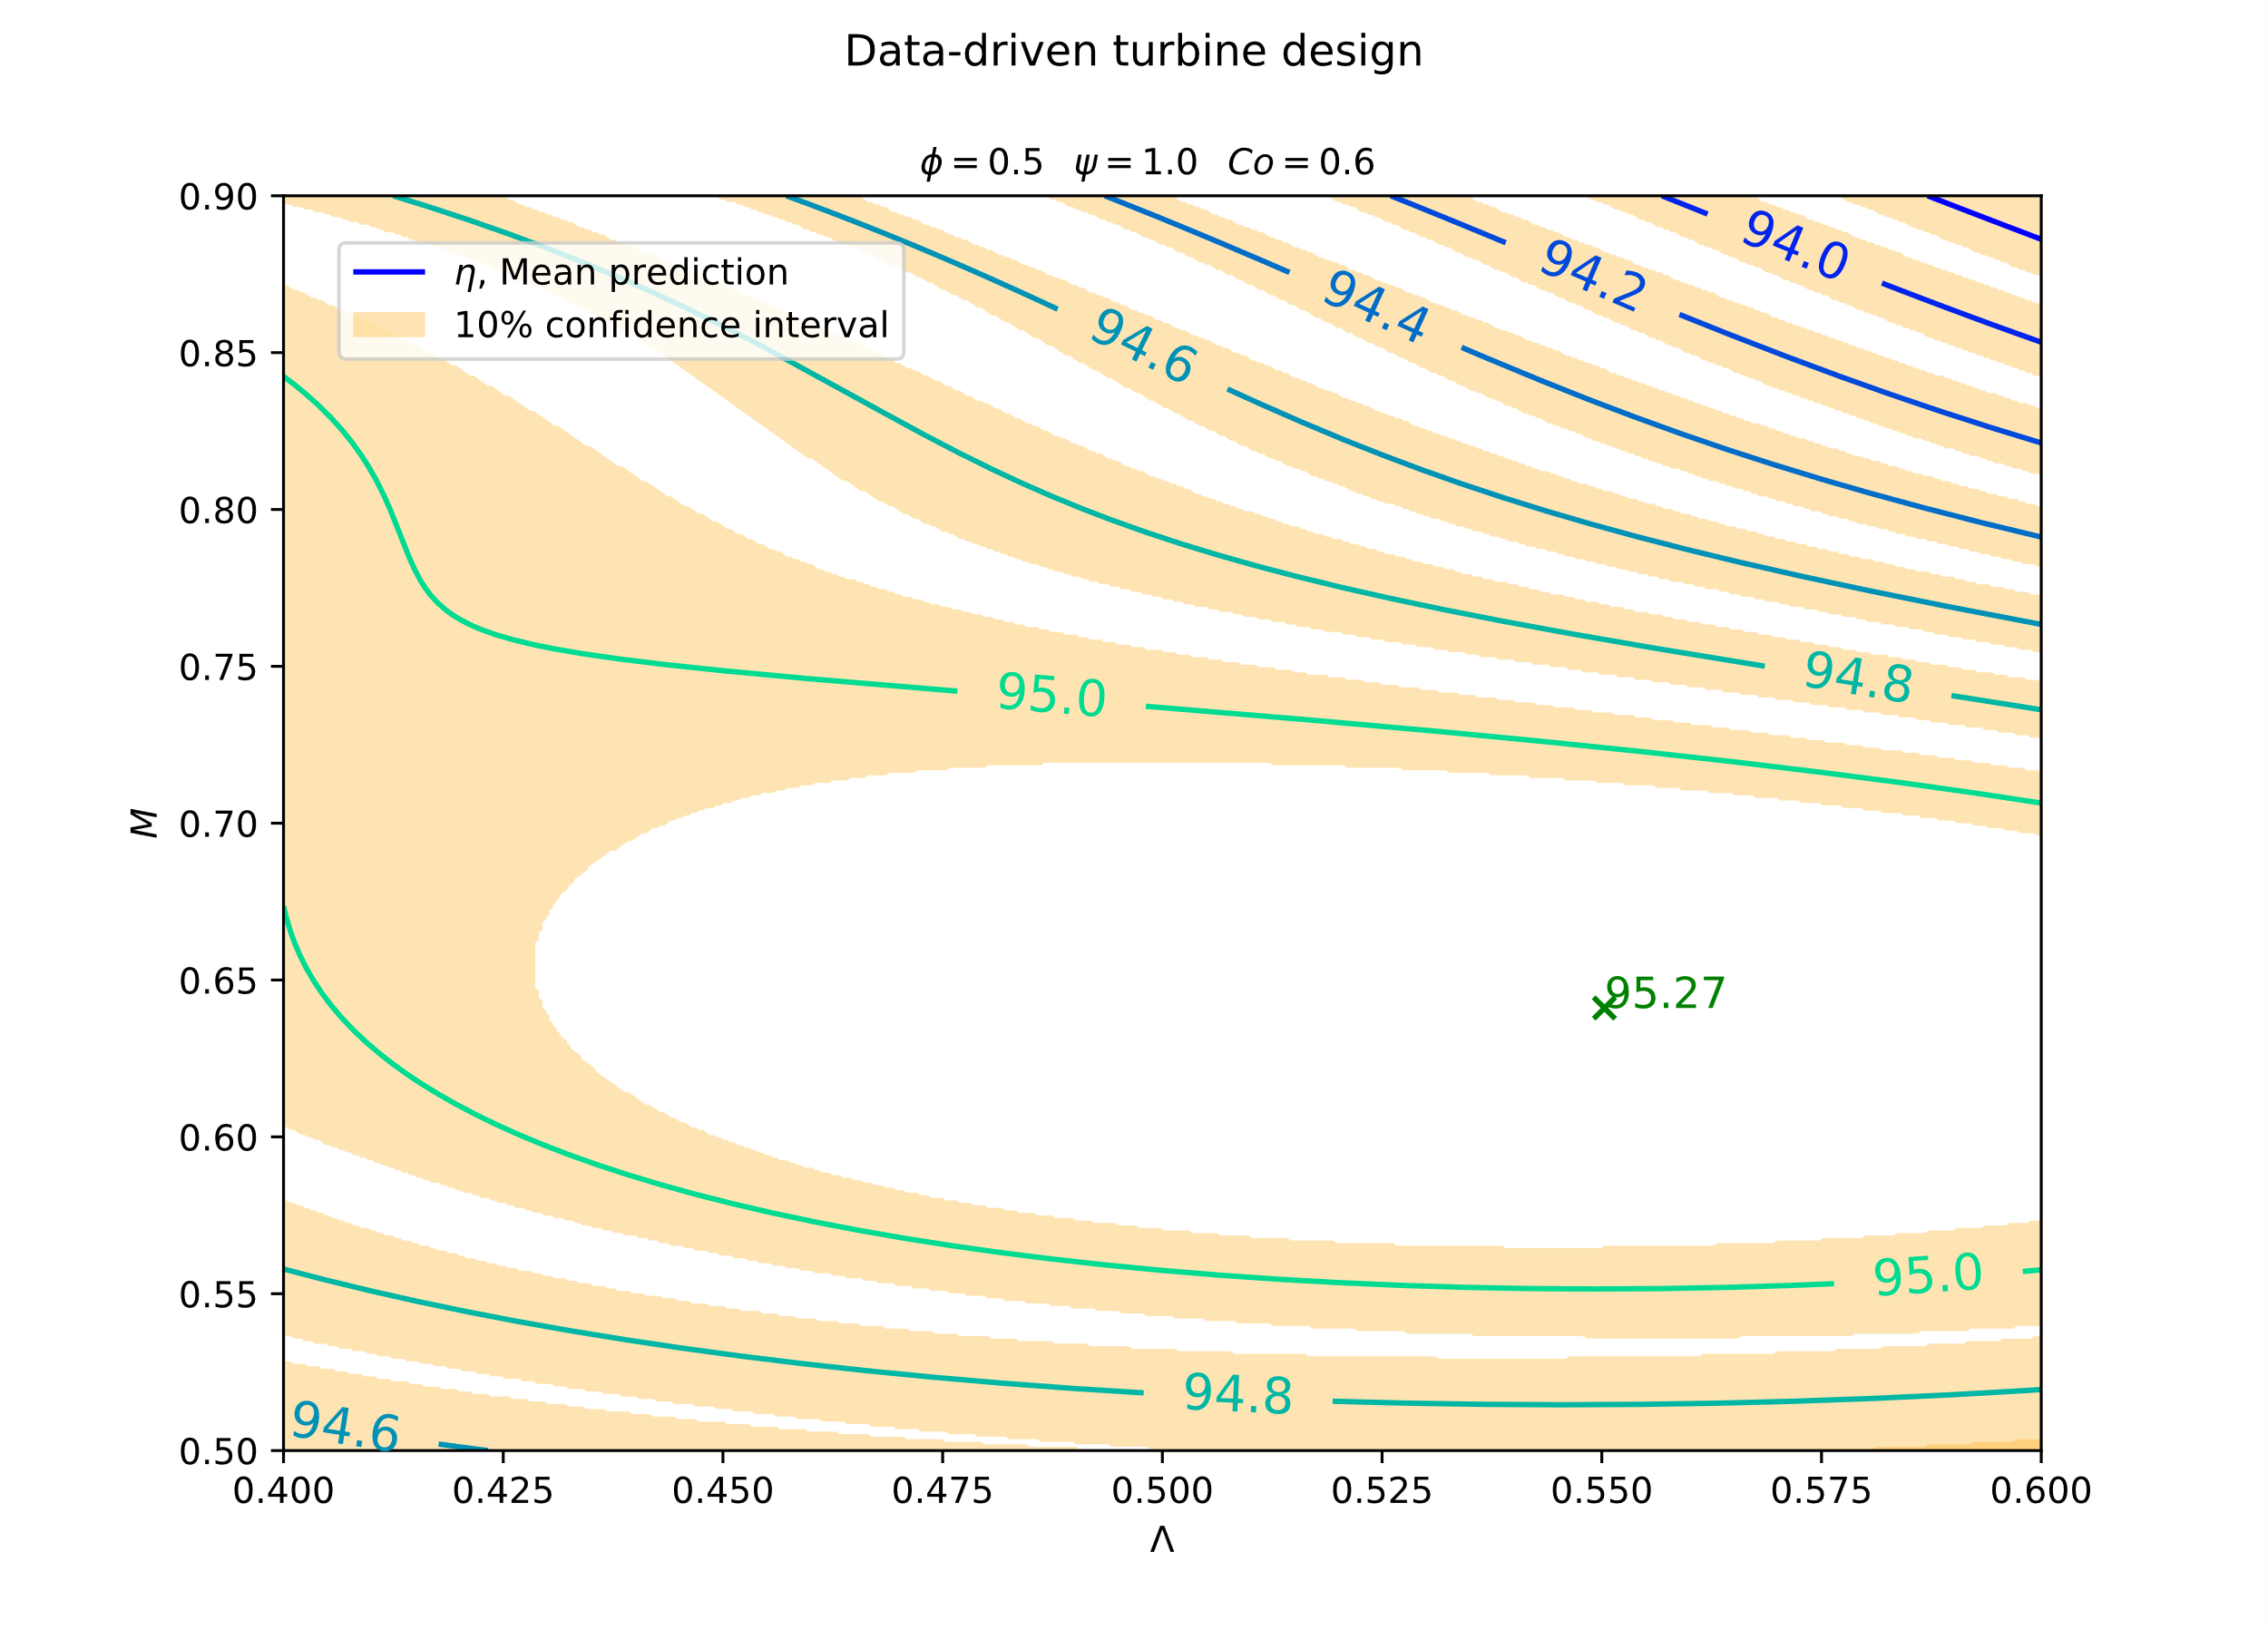
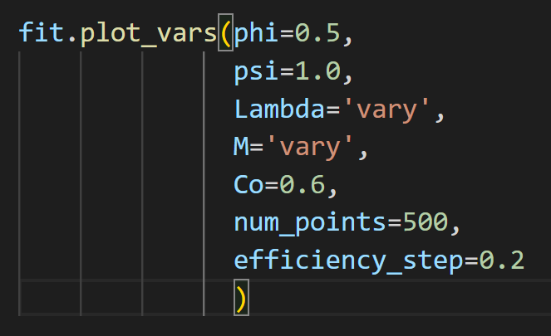
plot_vars (examples)

Slide 18
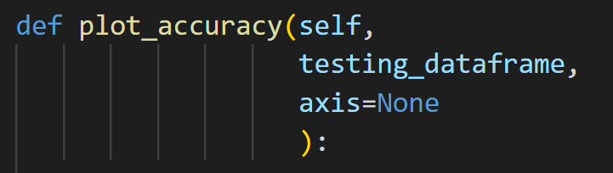
plot_accuracy

Slide 19
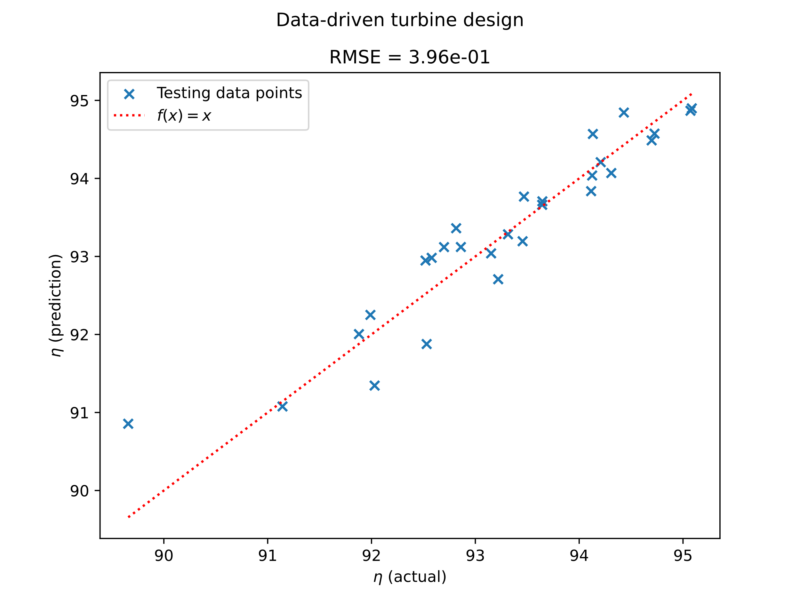
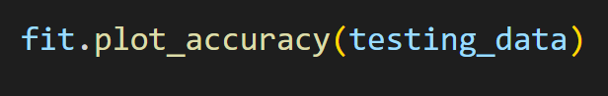
plot_accuracy (example)

Slide 20
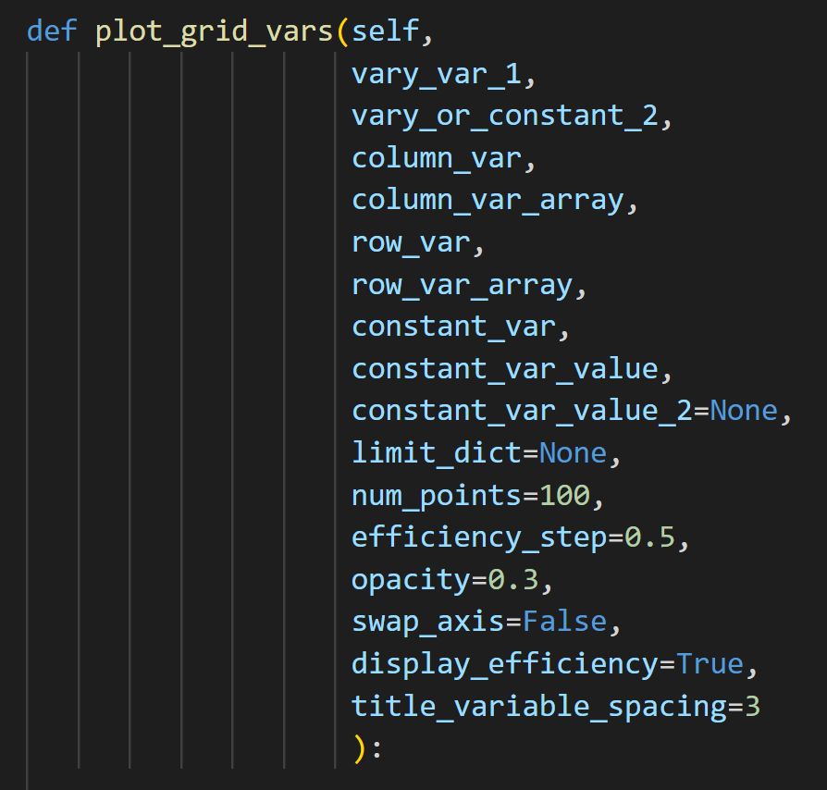
plot_grid_vars

Slide 21
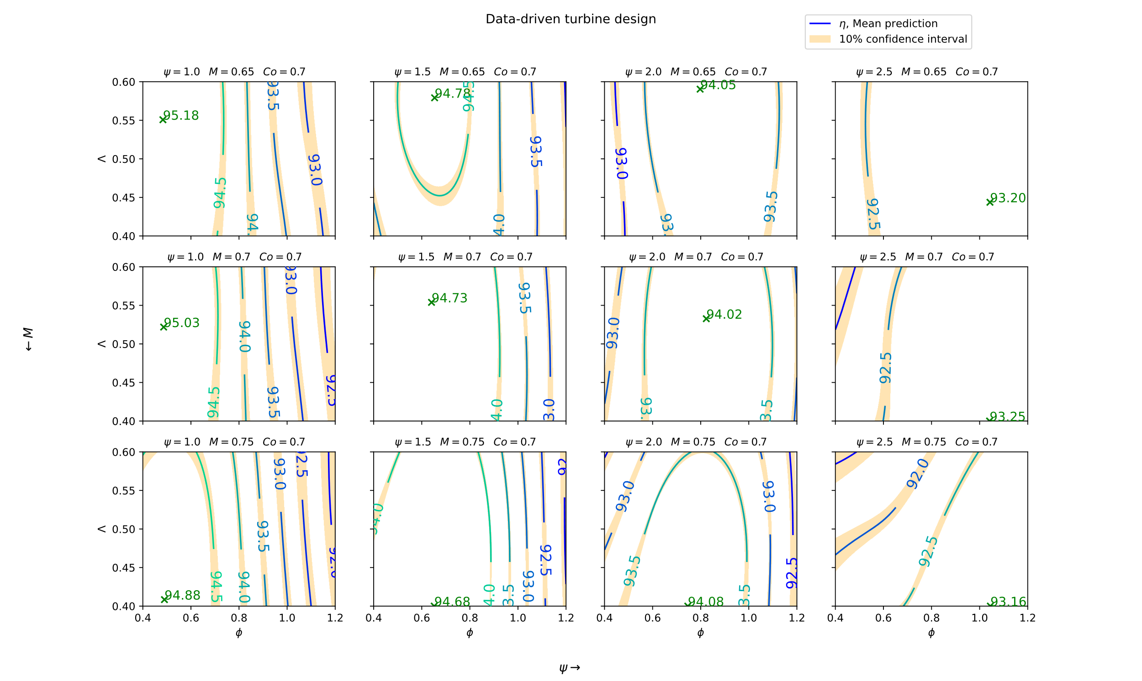
plot_grid_vars (examples)

Slide 22
Week 3

Slide 23
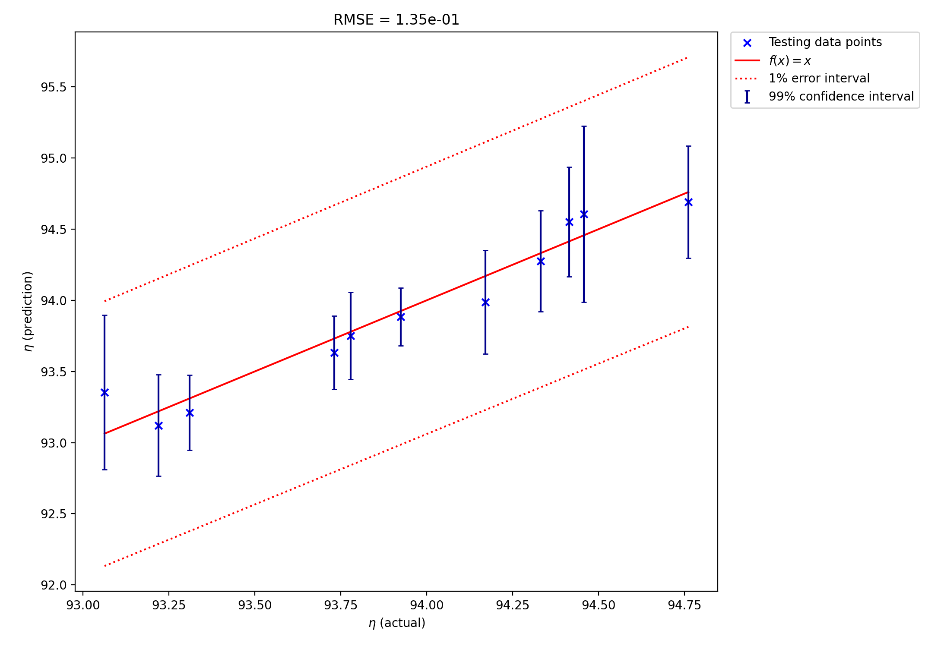
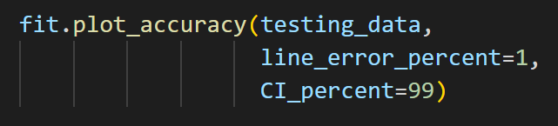
‘2D’ data accuracy
26 data points. Split into:
14 training points
12 testing points

Slide 24
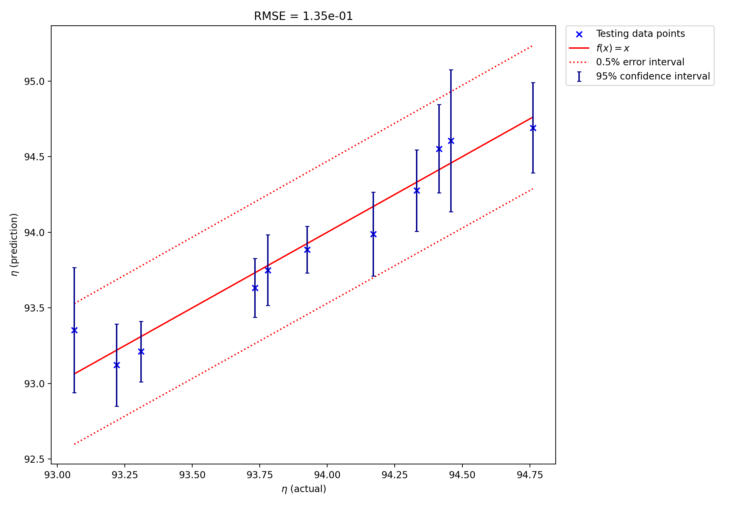
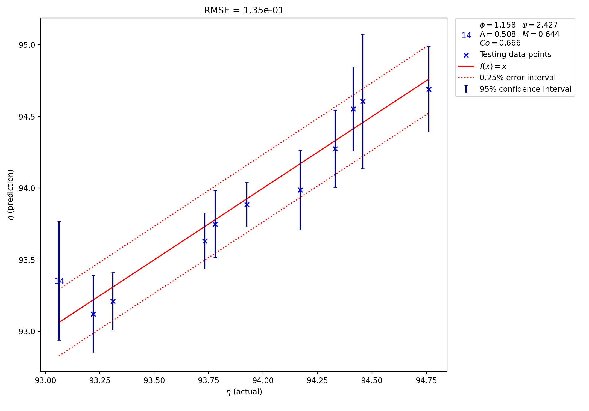
‘2D’ data accuracy

Slide 25
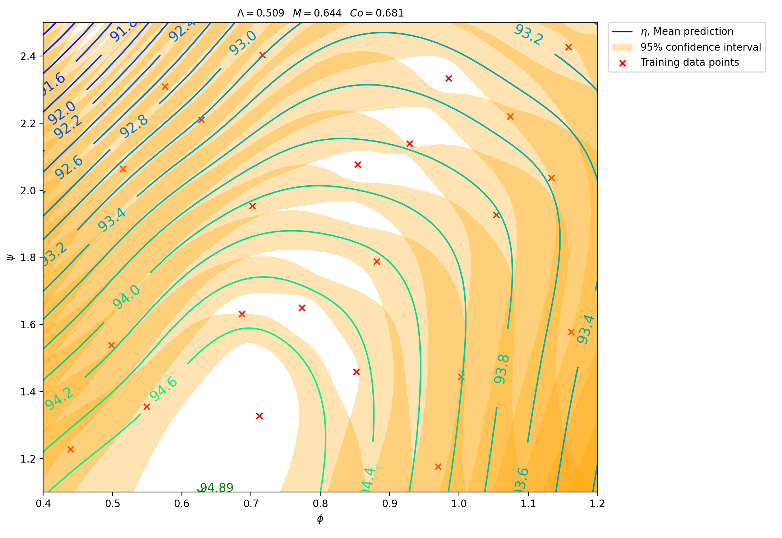
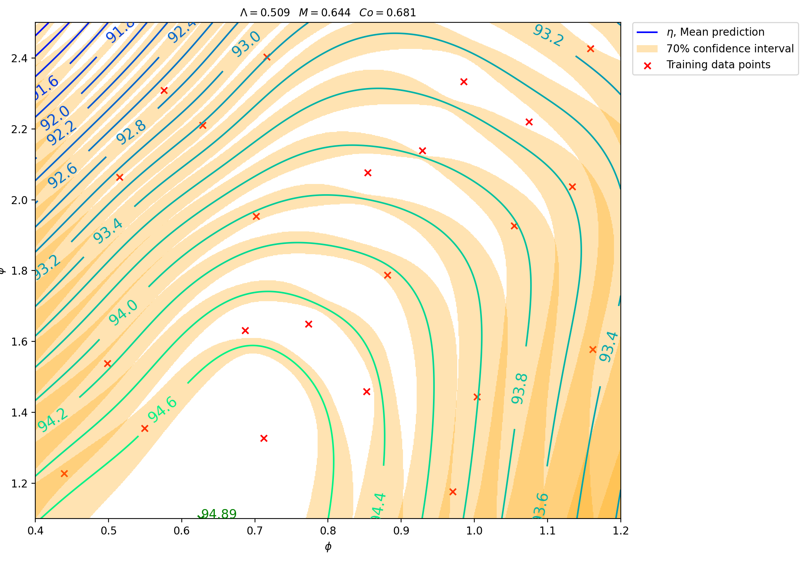
‘2D’ data plots (using 26 data points for model)

Slide 26
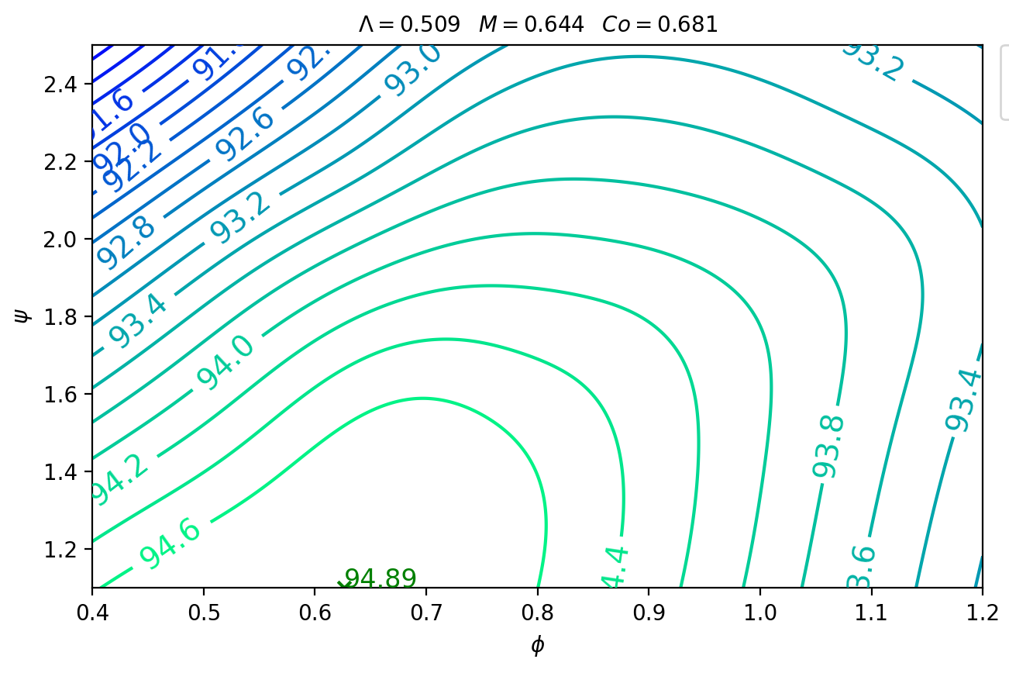
‘2D’ comparison to literature
Literature
Model

Slide 27
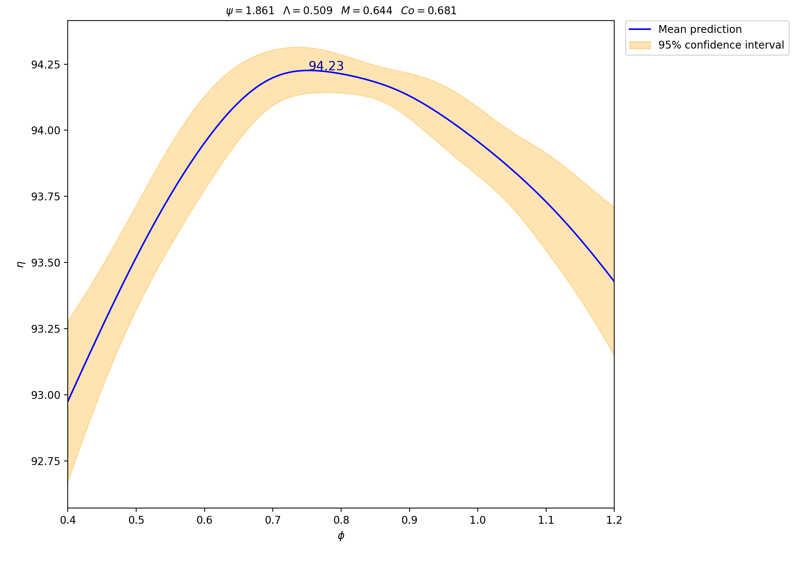
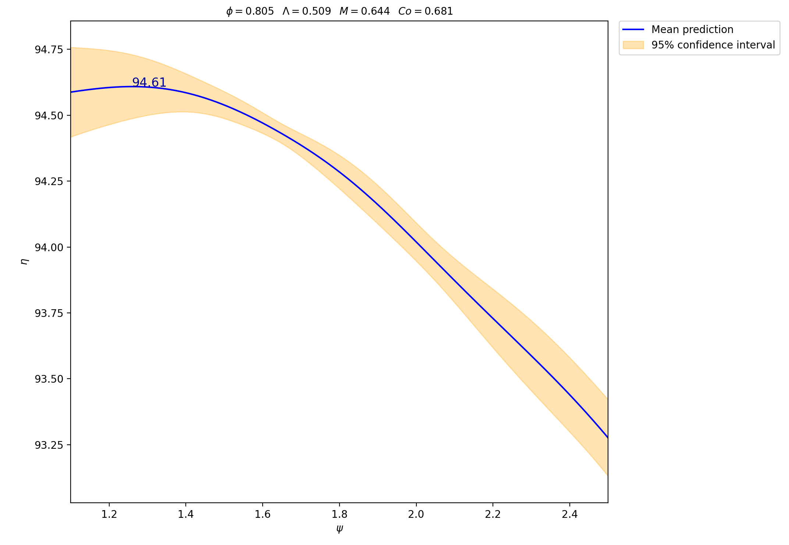
‘2D’ data 1D plots

Slide 28
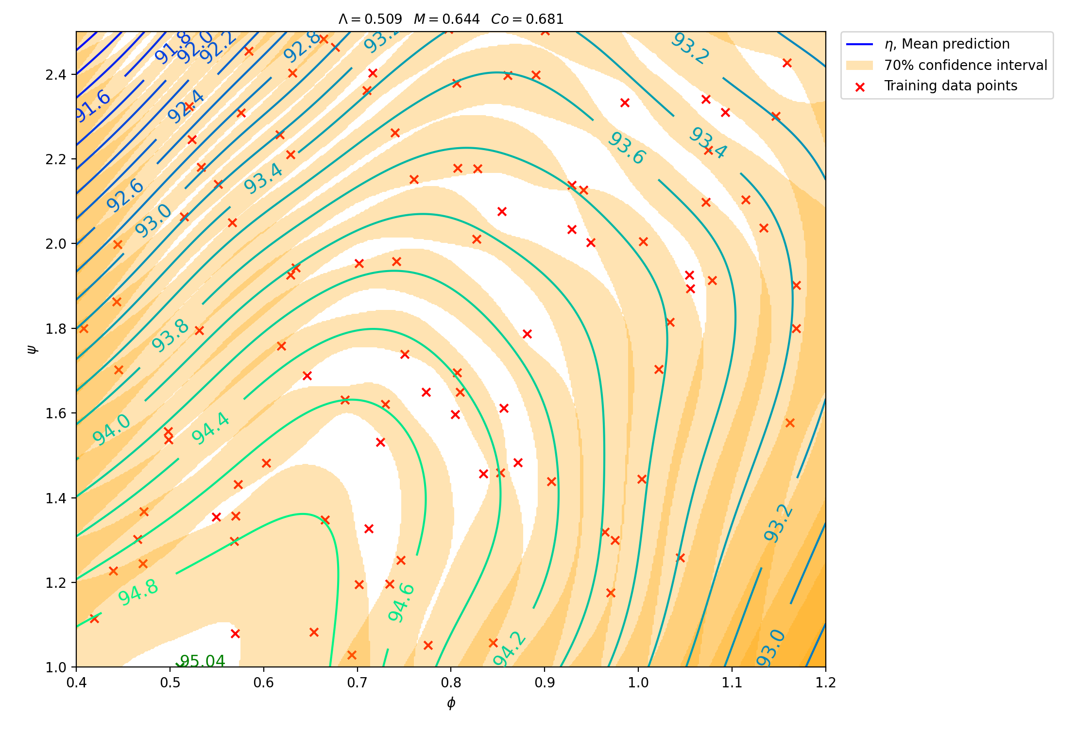
All 105 pieces of data
Model using all data points (105)
Model using just ‘2D’ data points (26)

Slide 29
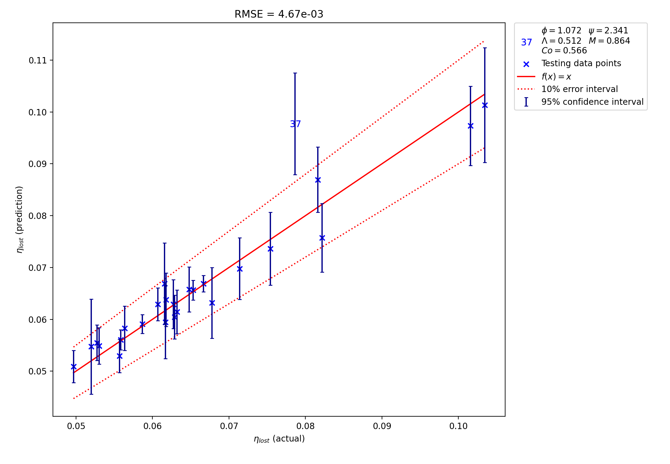
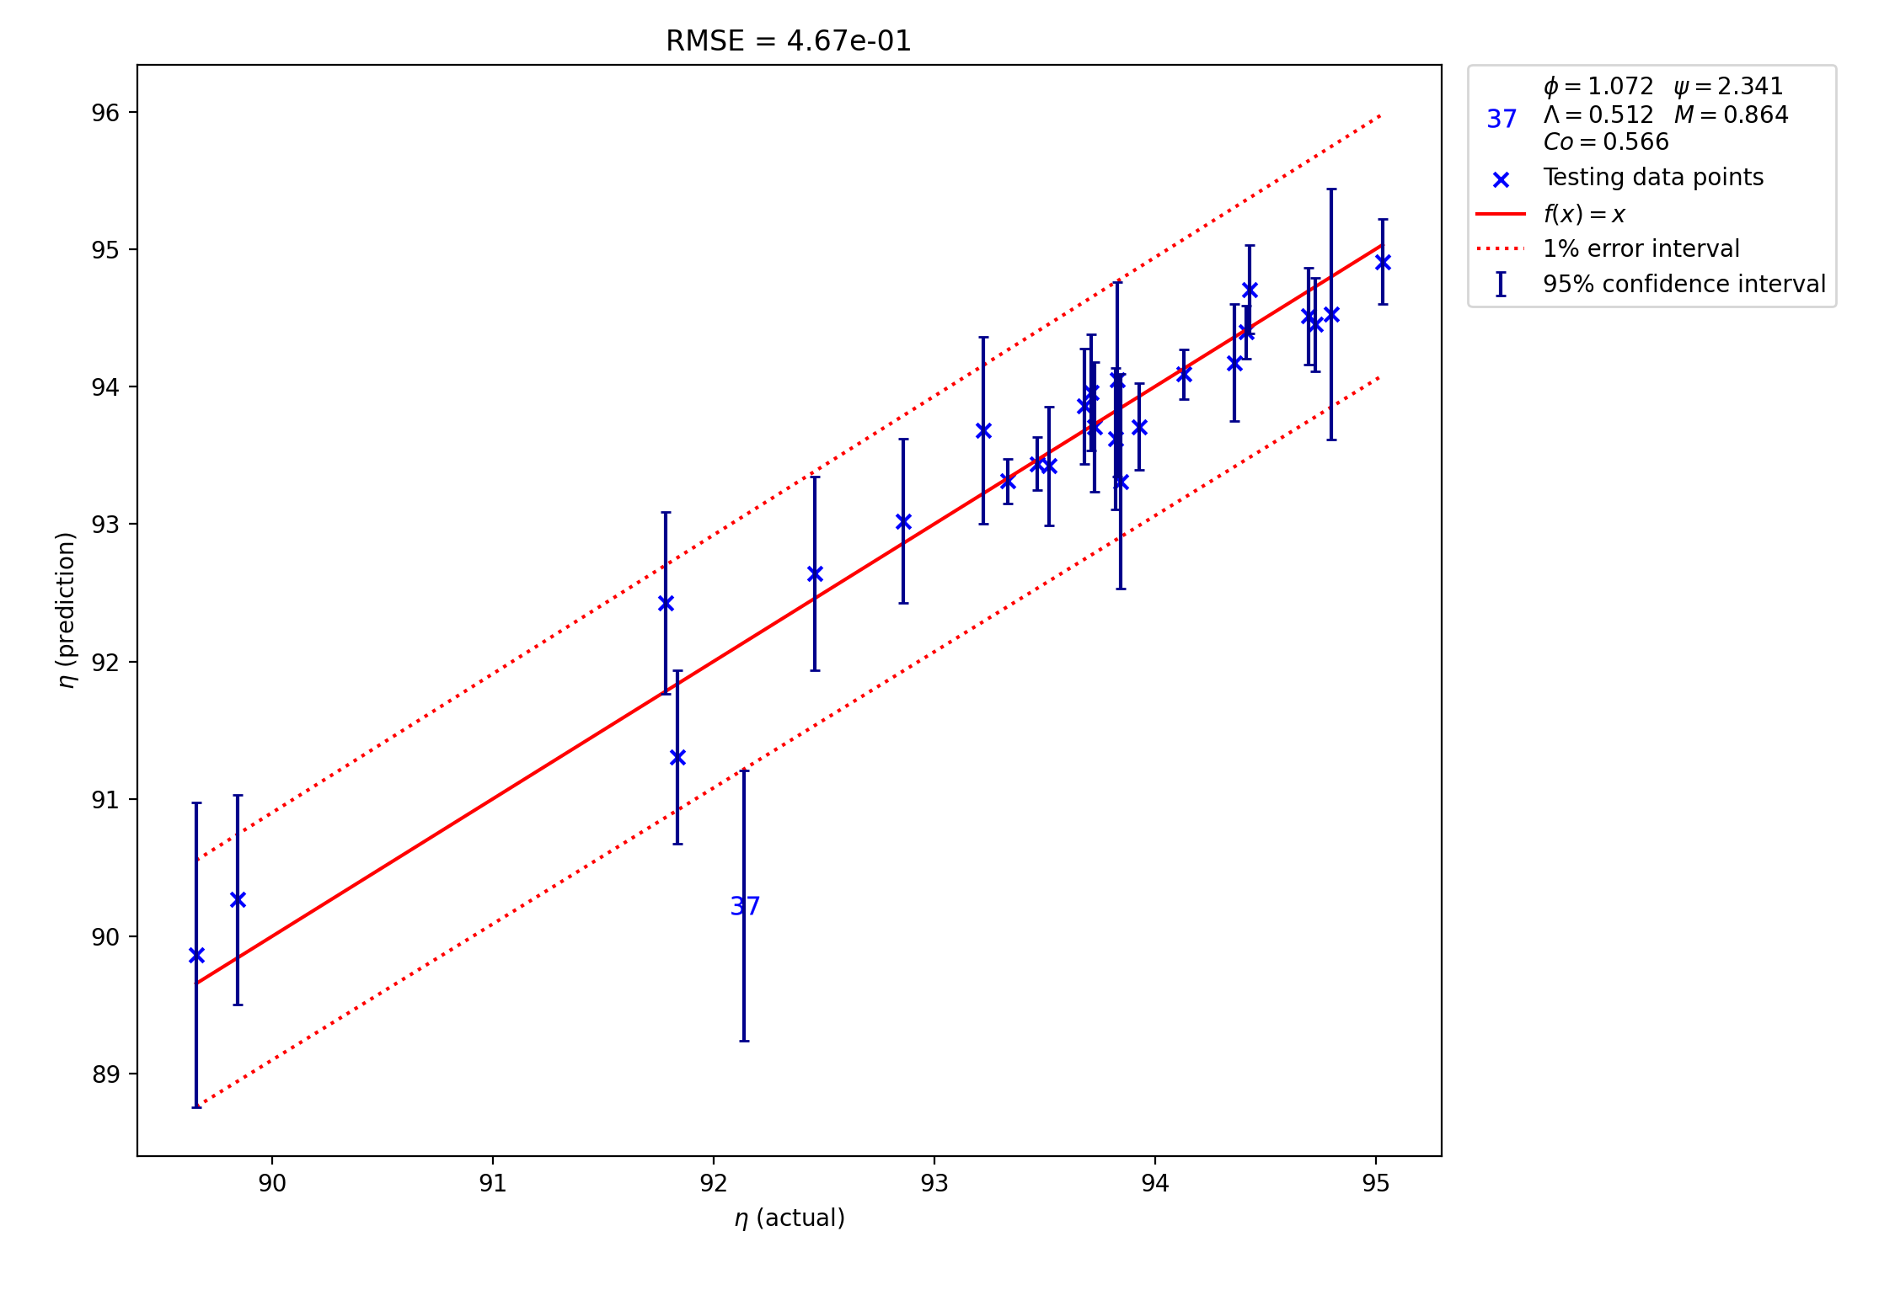
Accuracy of 105 data points
Plotting lost efficiency
Plotting efficiency

Slide 30
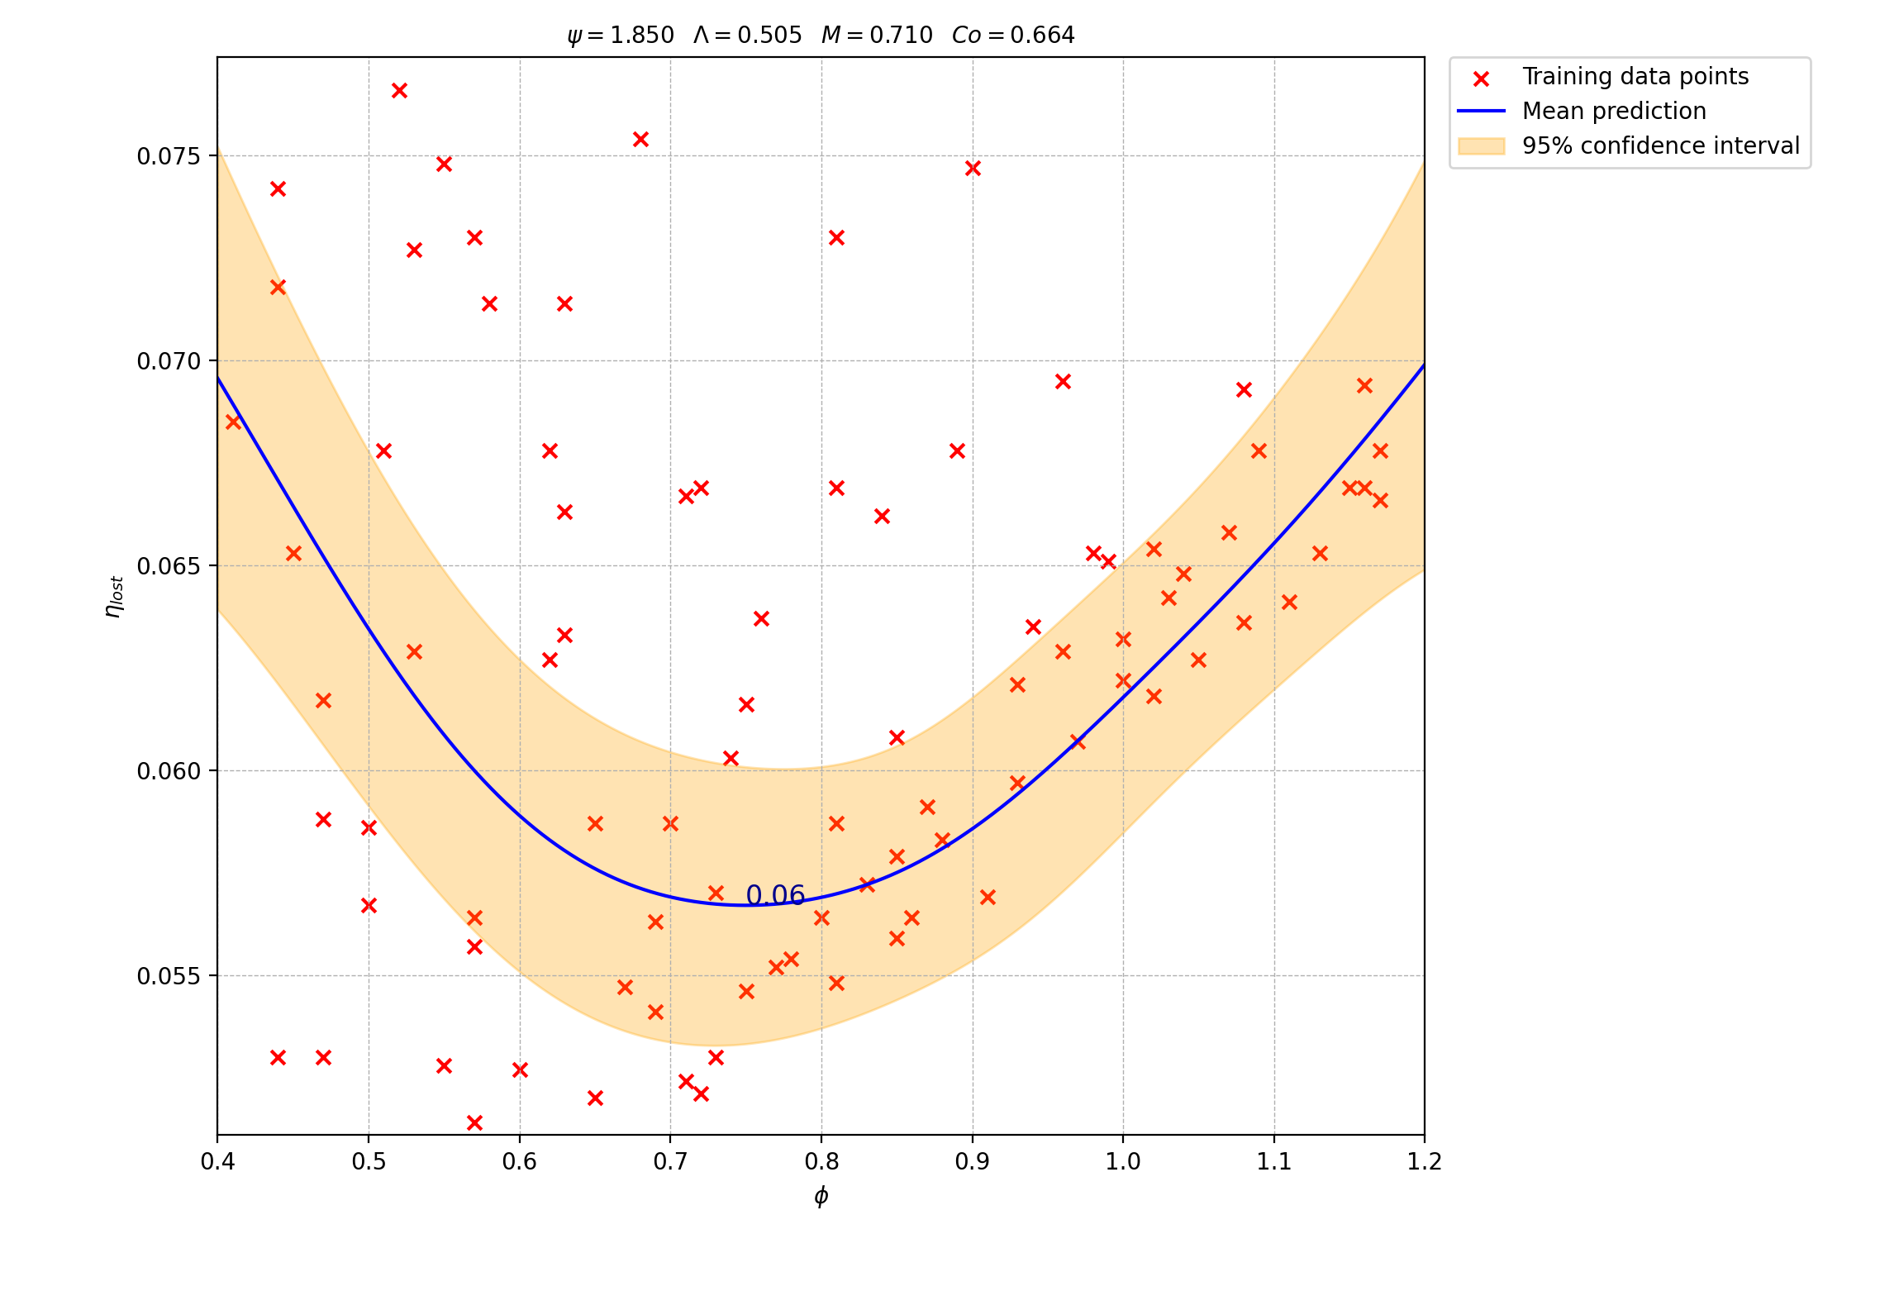
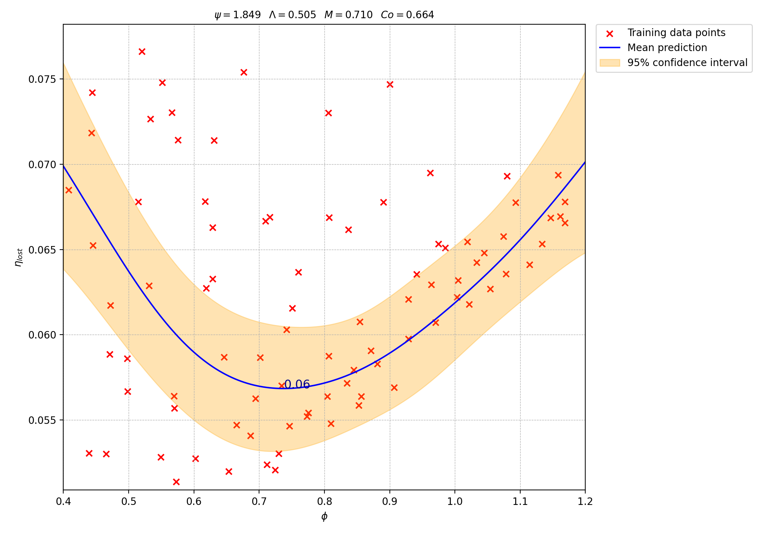
Effect of rounding dataframe values to 3sf
rounded
not rounded

Slide 31
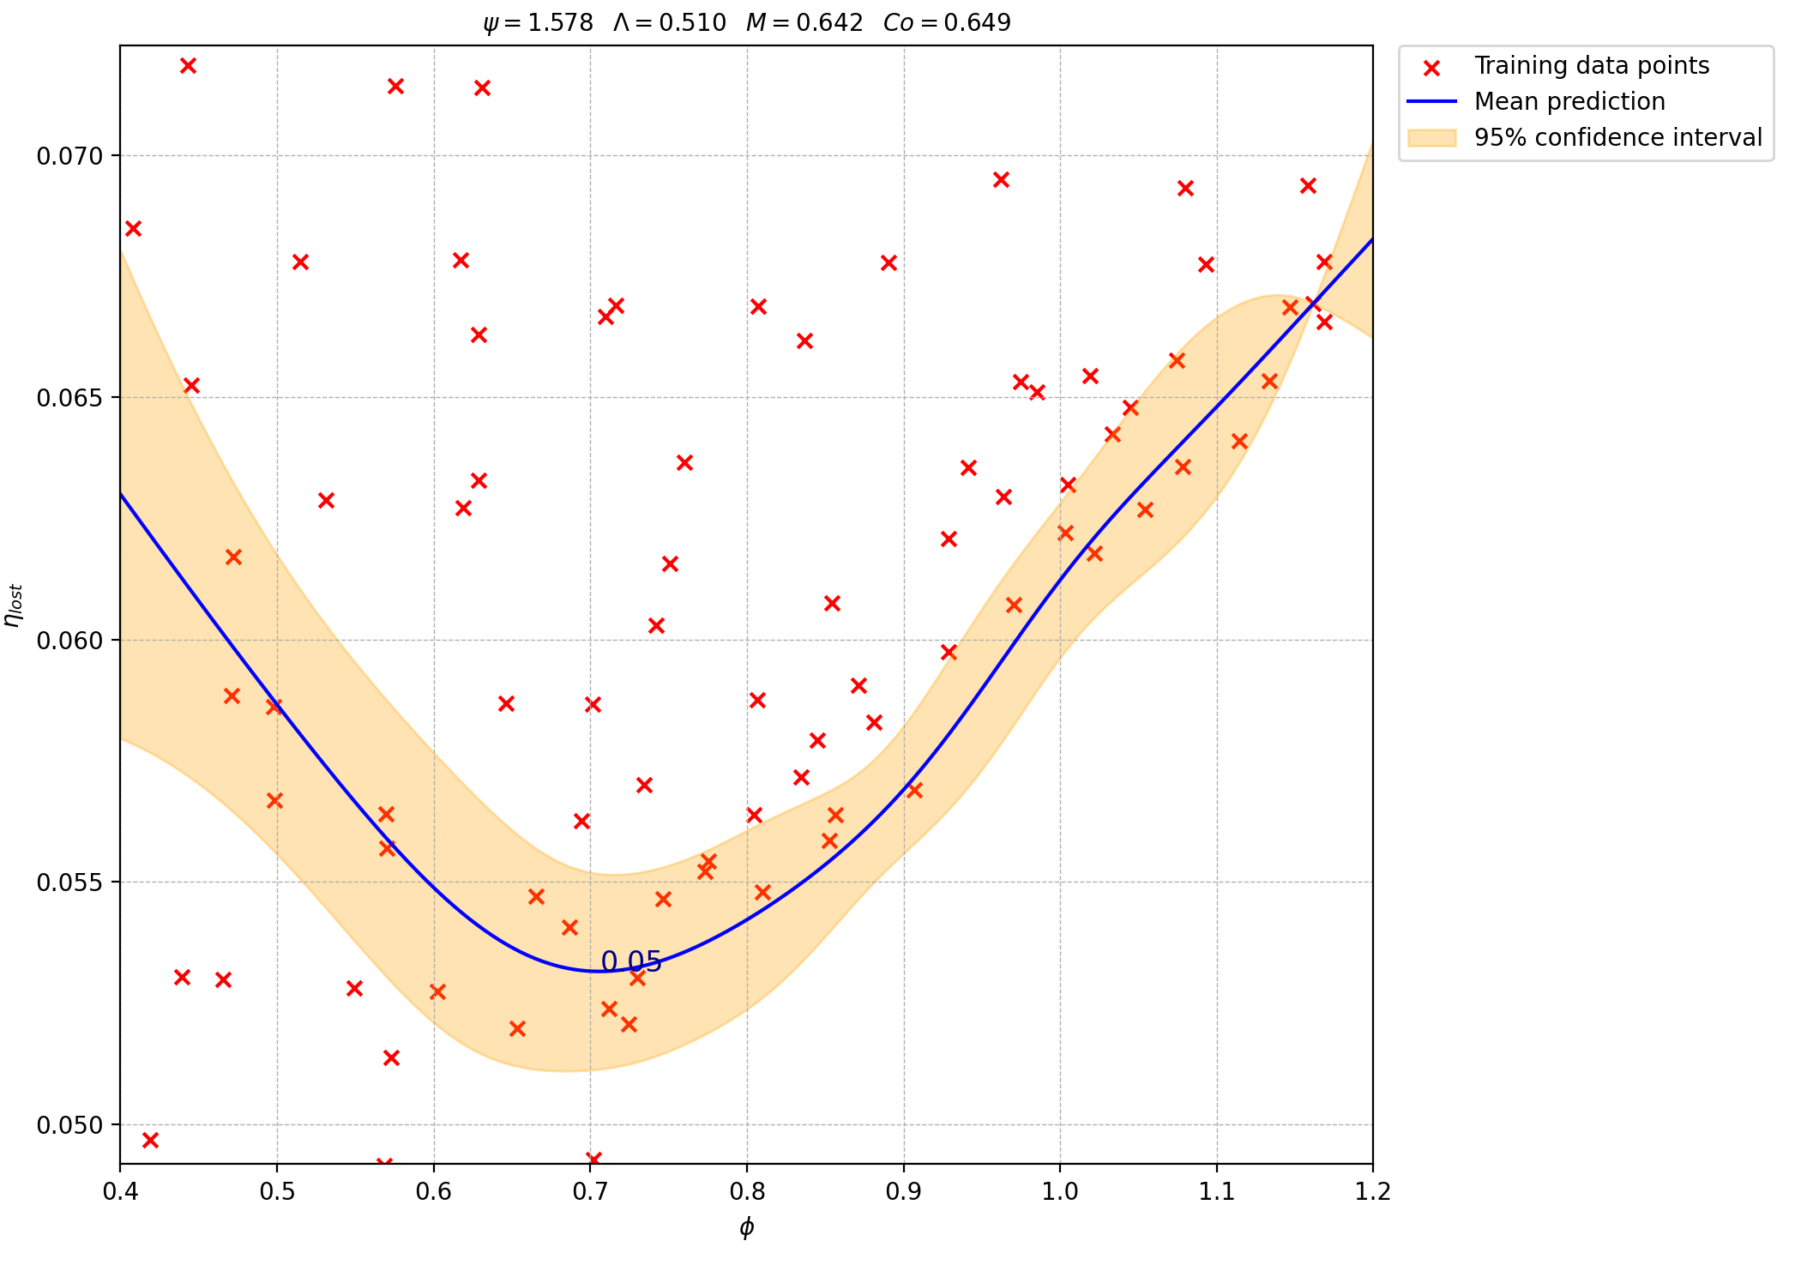

Varying $ϕ$ with other parameters fixed at an exact data point

Slide 32
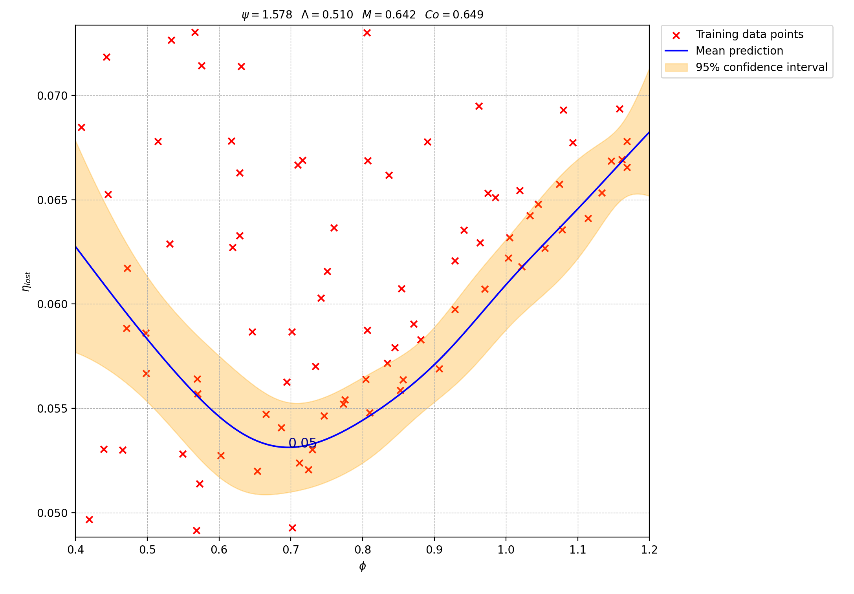
Effect of noise
No noise
Noise (alpha=1e-6)

